Slide 1

AI Job Analysis
- Ishika Patwa

Slide 2
INTRODUCTION
The dataset contains AI job postings with details like job titles, companies, skills, salaries, locations, and industries.
The raw dataset has 15,000 records with repeated values (skills, companies, industries).
To improve data quality and efficiency, it was normalized into multiple tables: Skills, JobSkills, Job Titles, Companies, Industries, Education, and Jobs.
The project applies SQL concepts (1NF, 2NF, 3NF) to eliminate redundancy and ensure referential integrity.
Enables insightful analysis such as top skills in demand, salary comparisons (USD vs INR), and job trends.

Slide 3
PROJECT OBJECTIVE
Build a structured relational schema (Jobs, Companies, Skills, JobSkills, Industries, Education, etc.) from the raw AI job dataset.
Link each job to its required skills to measure skill demand, multi-skill combinations, and gaps.
Perform salary comparison across Local, USD, and INR values and group results into custom salary ranges for benchmarking.
Analyse hiring patterns by company, industry, location, experience level, employment type, and education required.
Demonstrate core-to-advanced SQL (joins, aggregations) to generate decision-ready insights for hiring and compensation strategy.

Slide 4
KEY QUESTIONS
1.
What are the top 5 most in-demand skills in AI jobs?
2.
What is the average salary (in INR) for each experience level?
3.
Which currencies offer the highest average salary in INR when converted from local salary?
4.
Is remote work more common in certain industries?
5.
Which company offers the highest average salary in INR?
6.
Which country has the maximum number of employees' residences?
7.
What is the average salary (USD vs Local vs INR) for each job title?

Slide 5
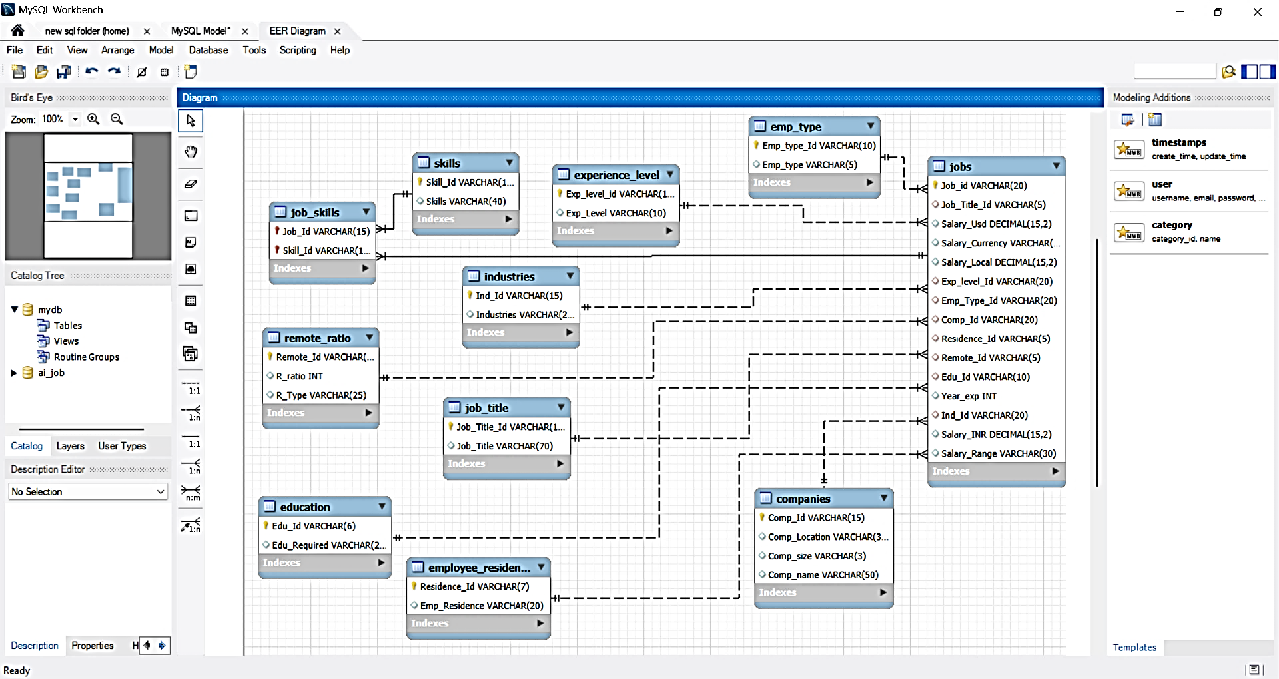
ER MODEL

Slide 6
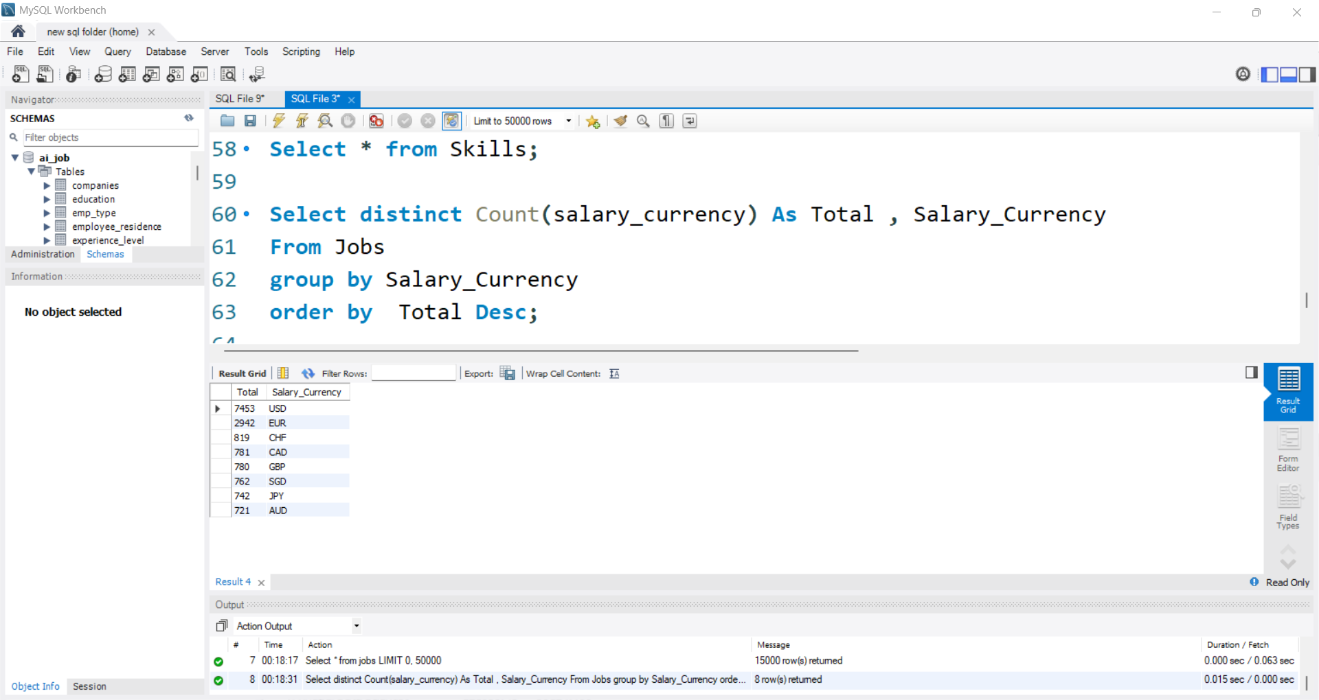
OVERVIEW
USD is the most used salary currency, showing most jobs are from the US or paid in dollars.
EUR is second, meaning many jobs are also from Europe or use the euro for payment.
United States Dollar
Euro
Swiss Franc
Canadian Dollar
Great British Pound
Singapore Dollar
Japanese Yen
Australian Dollar

Slide 7
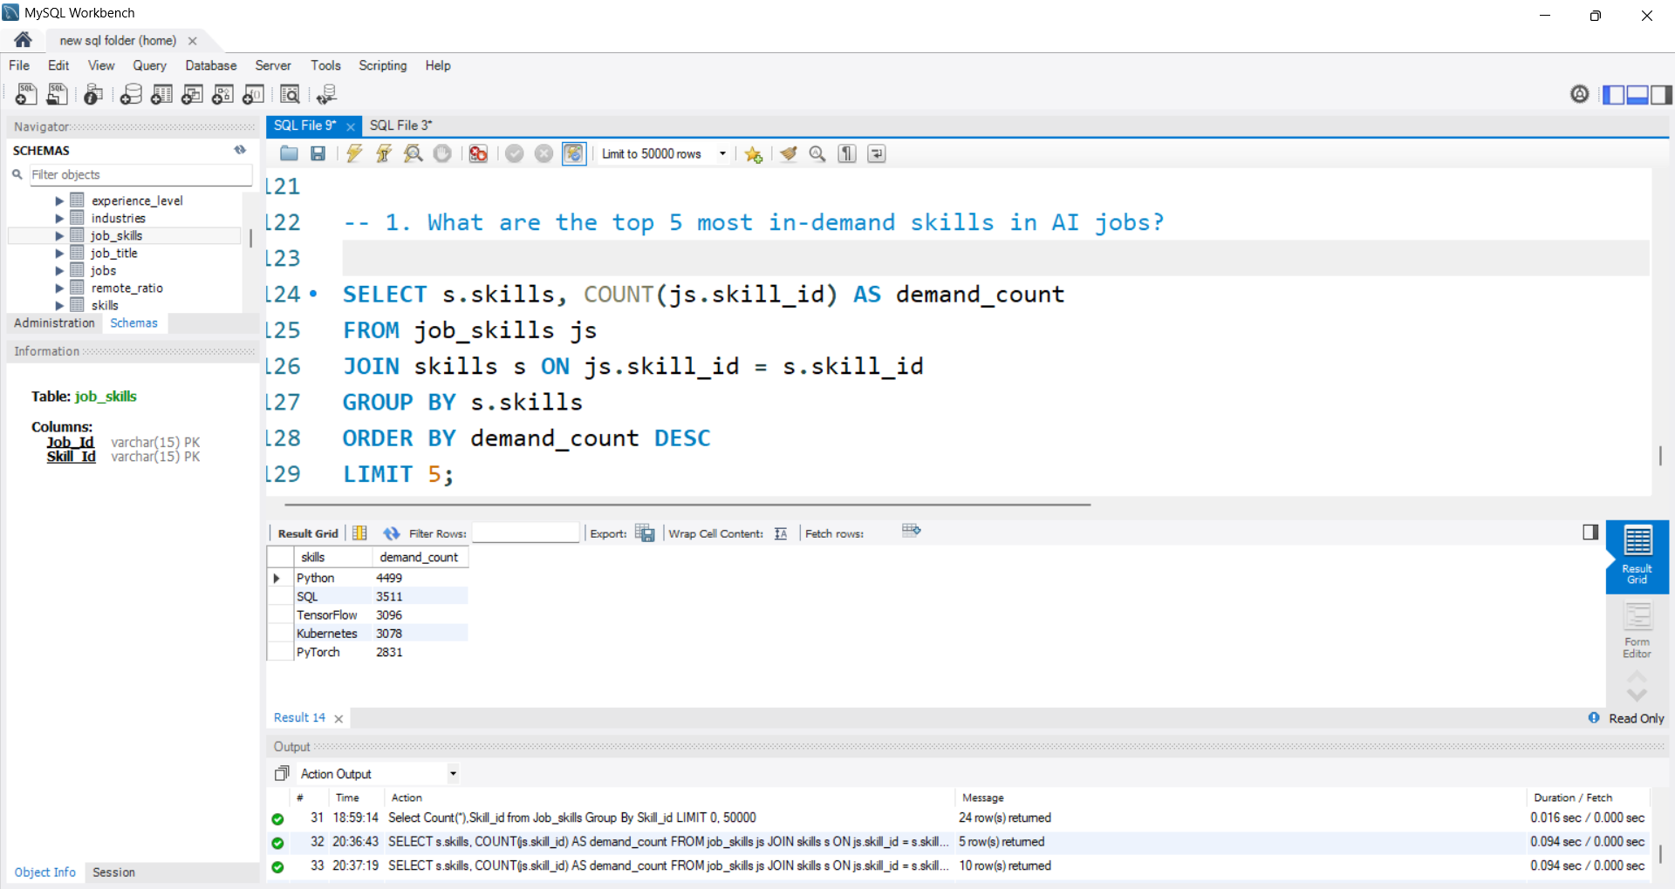
What are the top 5 most in-demand skills in AI jobs?
Python is the most in-demand skill in AI jobs, followed by SQL and TensorFlow, showing a strong need for both coding and machine learning tools.

Slide 8
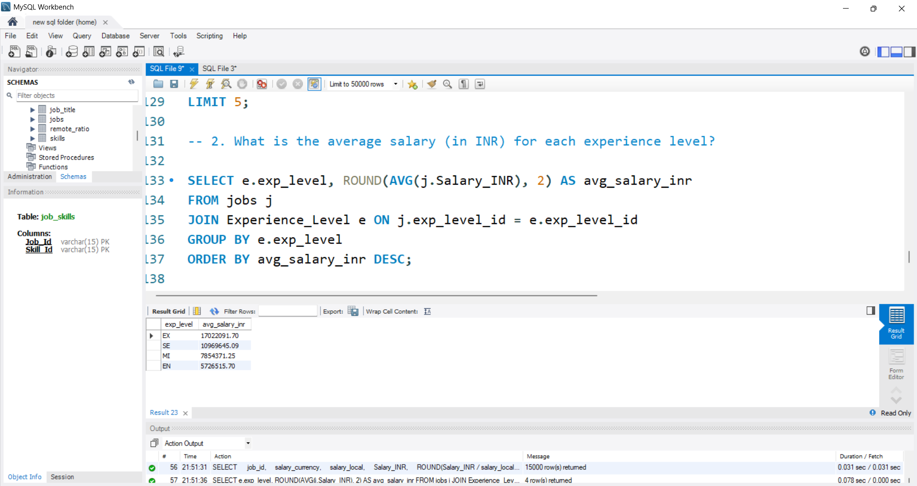
What is the average salary (in INR) for each experience level?
The jump in average salary from Mid (MI) to Senior (SE), and then to Expert (EX), is quite large — highlighting how salary grows steeply with expertise.

Slide 9
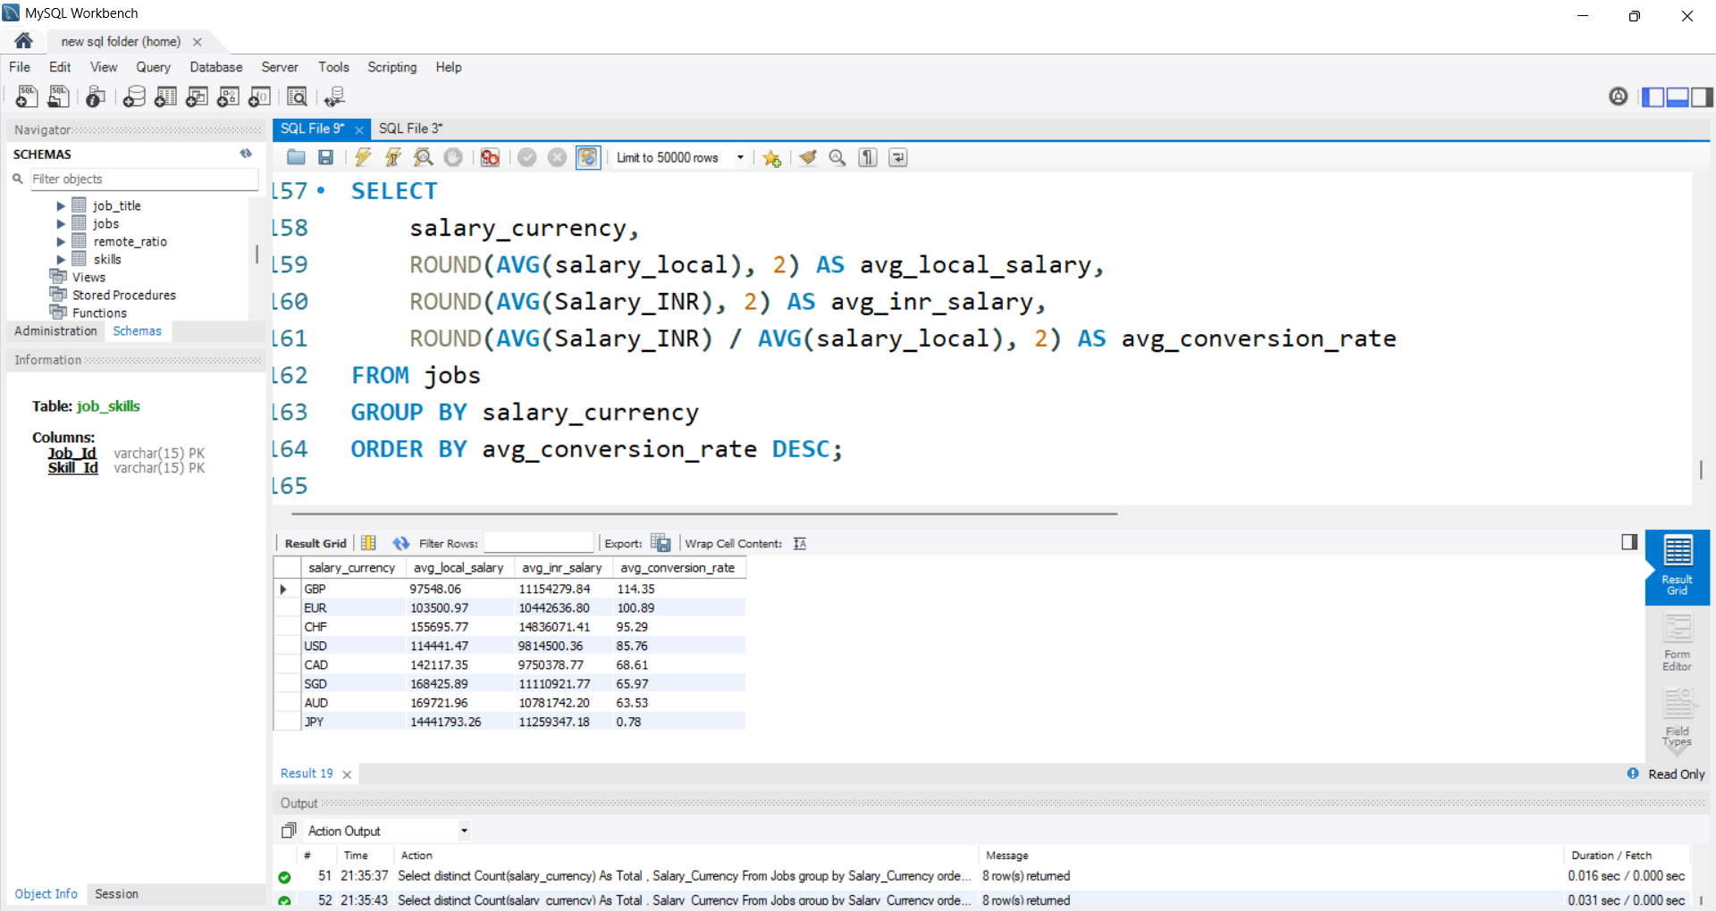
Which currencies offer the highest average salary in INR when converted from local salary?
Jobs paid in GBP and EUR convert to the highest INR value, while JPY and AUD offer the lowest — showing that not all high local salaries are equally valuable in INR.

Slide 10
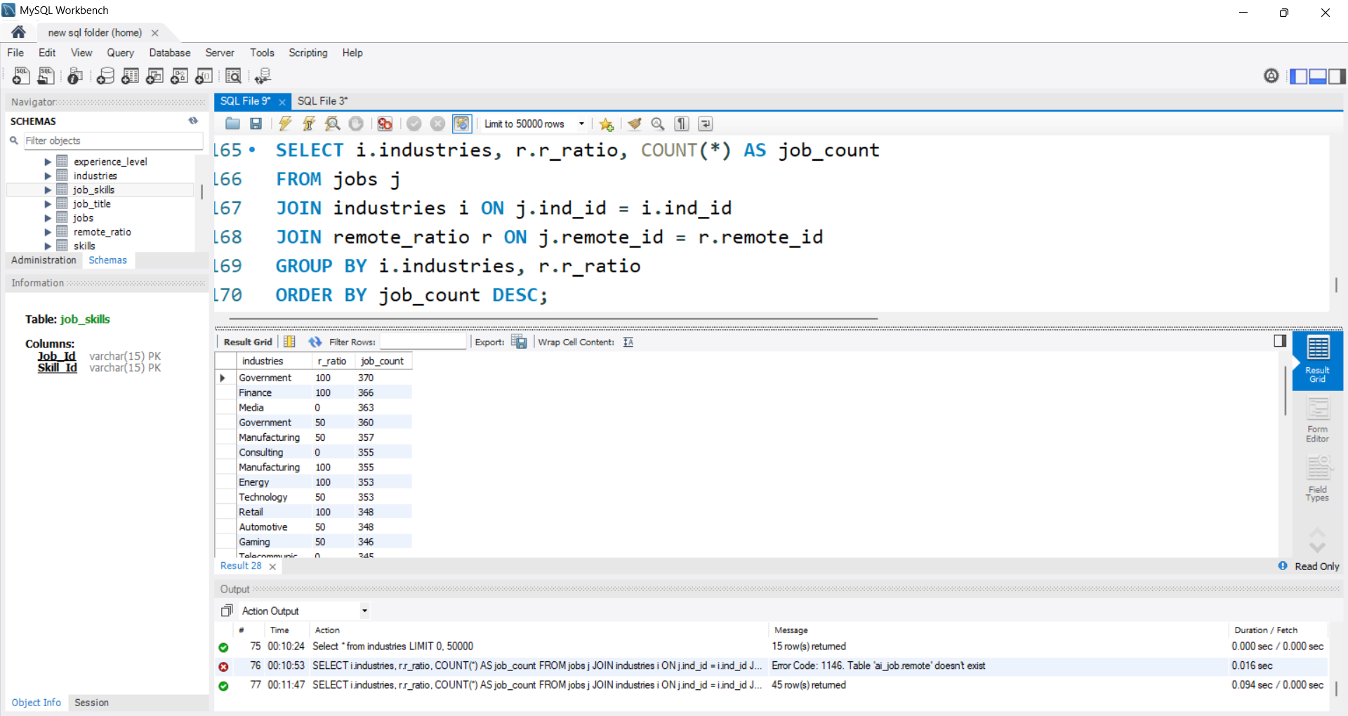
Is remote work more common in certain industries?
Government and Finance industries offer the highest number of remote jobs (r_ratio = 100), indicating a strong shift toward fully remote opportunities in these sectors.

Slide 11
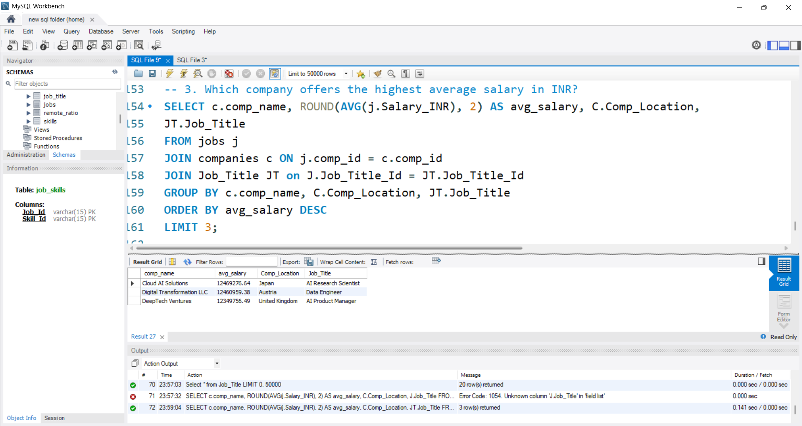
Which company offers the highest average salary in INR?
Cloud AI Solutions provides the highest average salary in INR, especially for AI Research Scientist roles based in Japan.

Slide 12
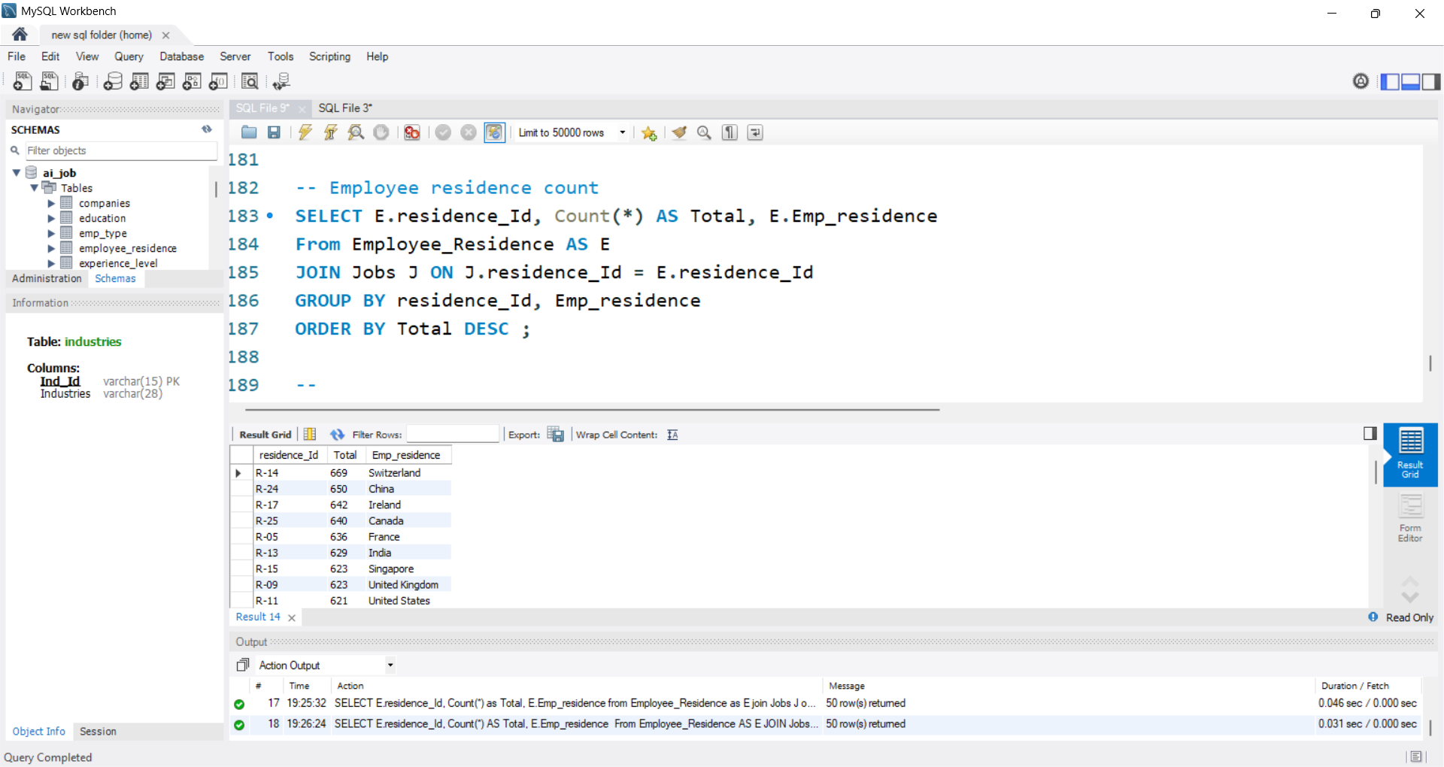
Which country has the maximum number of employees' residences?
Top Residences: Switzerland (669), China (650), Ireland (642), Canada (640), France (636).
Observation: India (629) and the United States (621) also have significant representation, reflecting their large talent pools.

Slide 13
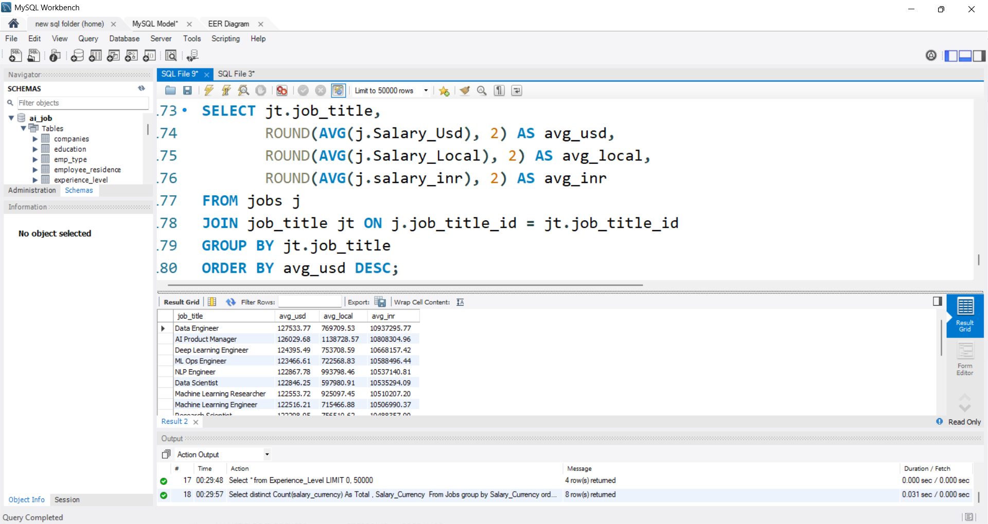
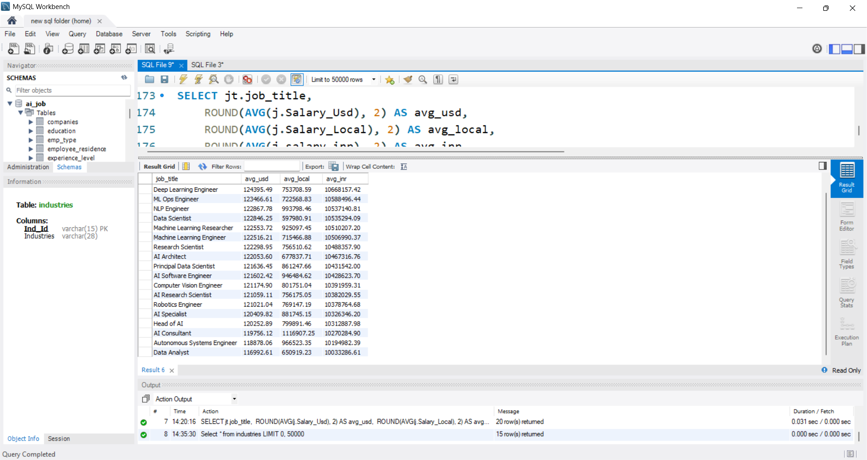
What is the average salary (USD vs Local vs INR) for each job title?
Data Engineer earns the highest average salary at $127,533.77 (₹ 1.08 Cr).
While local salaries (avg_local) appear moderate (e.g., around 7–11 Lakhs in local currency), their conversion into INR is very high (₹1+ Crore) due to currency exchange rates.

Slide 14
CONCLUSION
Successfully transformed 15,000+ unstructured AI job records into a clean, query-ready relational database.
Created 7+ linked tables (Jobs, Companies, Skills, JobSkills, Industries, Education, Job Titles) to simplify analysis and reporting.
Discovered key hiring trends, such as top in-demand skills, highest-paying job roles, and industry-wise salary patterns.
Performed multi-currency salary analysis (Local, USD, INR) and built custom salary ranges for better market insights.
Designed a scalable SQL database capable of handling advanced queries and future enhancements.

Slide 15
THANK YOU…!

